Slide 1
Node js
Day 4
shimaa ismail

Slide 2
content
views
Template Engine
cors
serve static file
multer

Slide 3
Template Engine
enables you to use static template files in your application. At runtime, the template engine replaces variables in a template file with actual values, and transforms the template into an HTML file sent to the client. This approach makes it easier to design an HTML page.
EJS | pug | handlebars
HTML-like with <% %> tags | Indentation-based, no closing tags | <h1>{{title}}</h1>

Slide 4
CORS
CORS (Cross-Origin Resource Sharing) is a security mechanism that blocks web pages from making requests to a different origin (domain, protocol, or port) than the one that served the page
Common Scenario
Frontend: http://localhost:3000
Backend API: http://localhost:5000
When your frontend tries to call the backend, the browser blocks it with a CORS error.

Slide 5
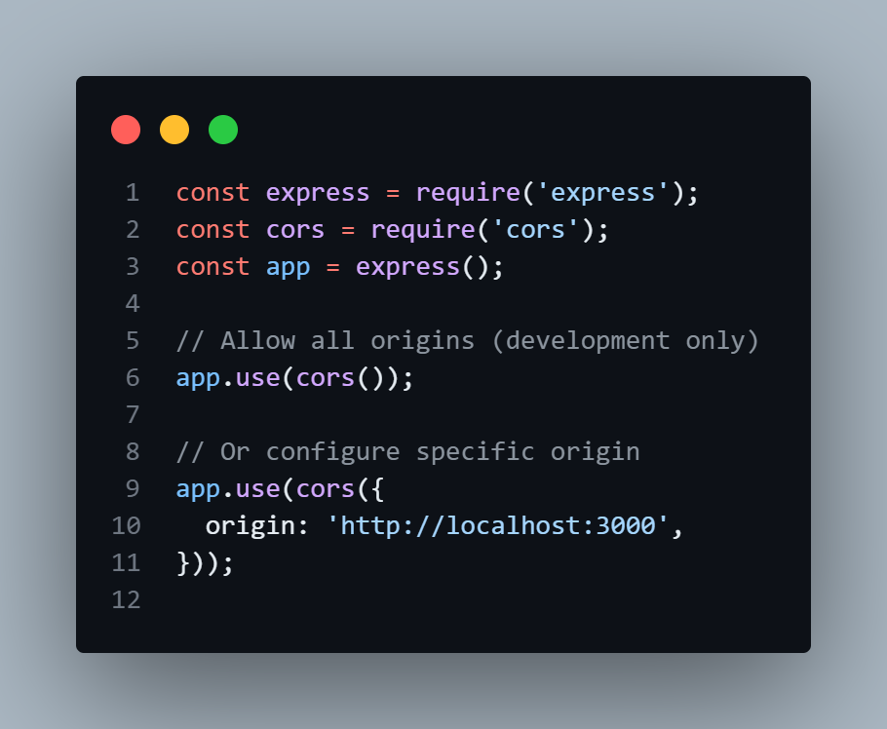
Enable Cross-Origin Resource Sharing
install cors
npm i cors

Slide 6
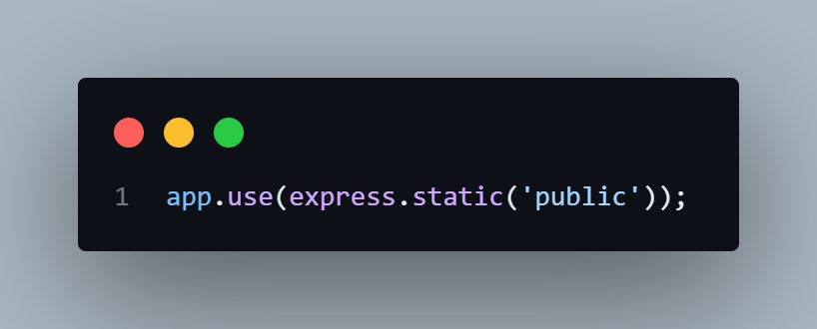
serve static file
ExpressJS provides built-in middleware to serve static assets efficiently, making it easy to deliver files like HTML, CSS, JavaScript, and images to clients.
http://localhost:3000/images/imgName || file name

Slide 7
Multer
Multer is an npm package commonly used in Node.js applications for handling file uploads.
Features of npm multer ::
File Uploads: Allows uploading files from client-side forms to the server.
Middleware: Integrates seamlessly with Express.js middleware, making it easy to handle file uploads within routes.
npm install multer

Slide 8
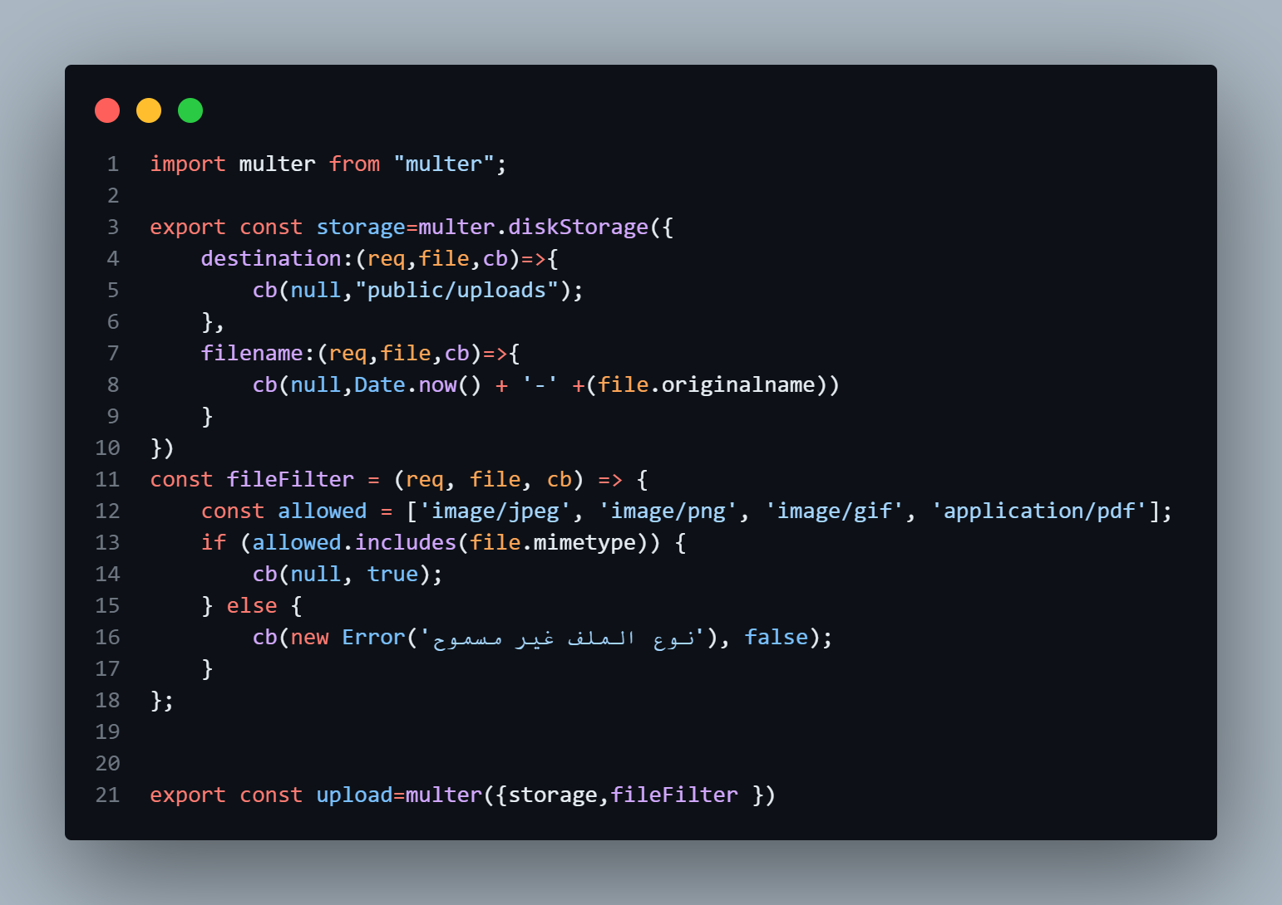
multer config

Slide 9
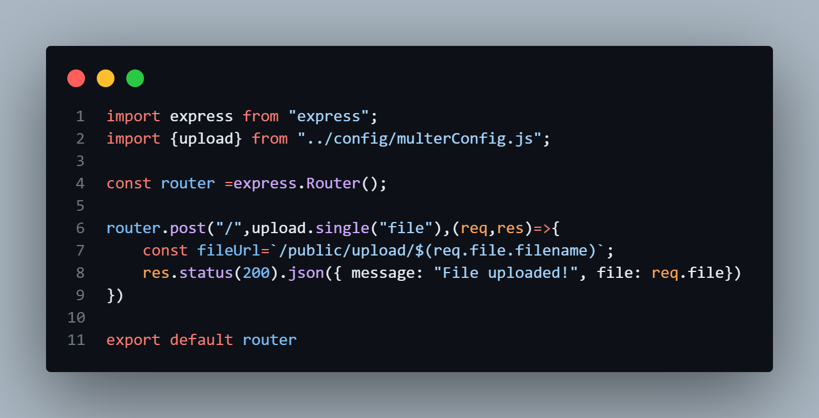
uploadRoute

Slide 10
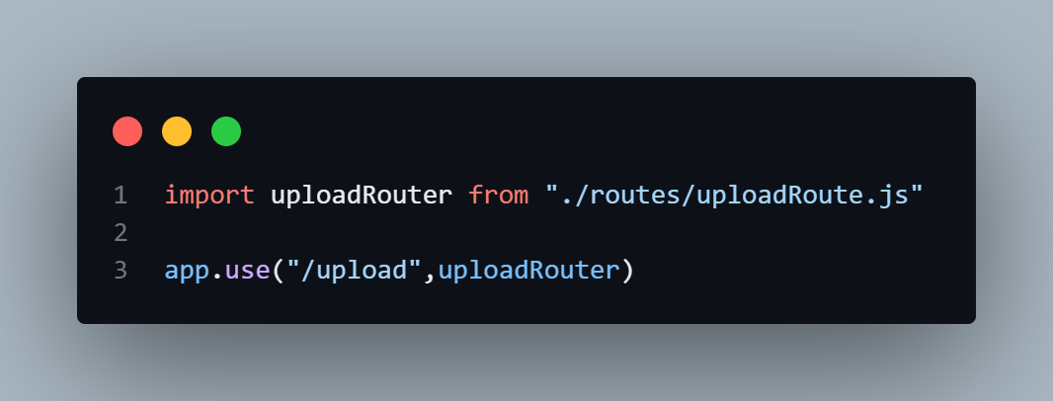
server.js

Slide 11
THANK YOU

